Slide 1
Defense Against the Dark Arts
Protecting yourself against internet villains
Thomas Rayner

Slide 2
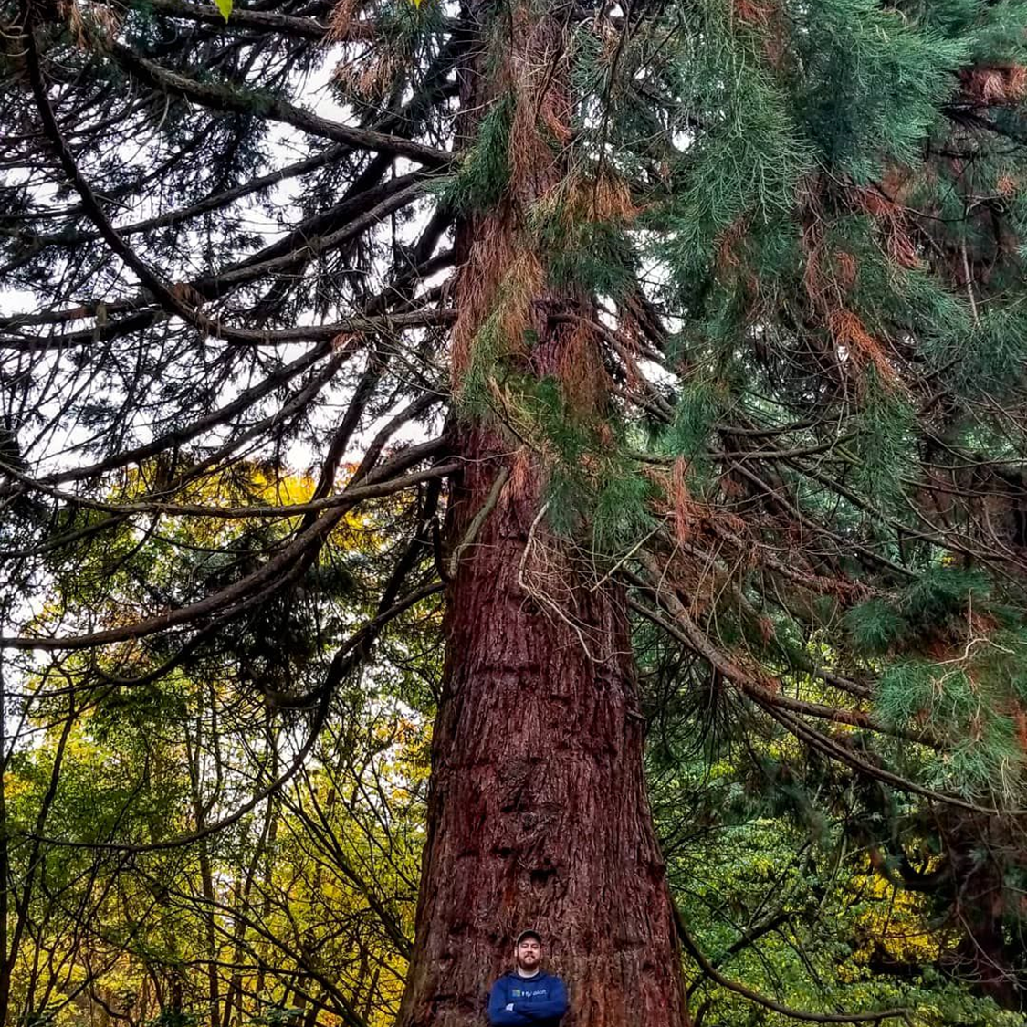
Thomas Rayner
Certified Information Systems Security Professional (CISSP)
Sr Security Service Engineer @ Microsoft
@MrThomasRayner
thomasrayner.ca | PowerShell Discord/Slack aka.ms/psdiscord aka.ms/psslack
github.com/thomasrayner | pluralsight.com/authors/thomas-rayner
✔

Slide 3
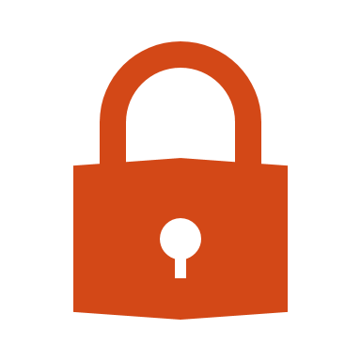
So, you think you're unhackable? 1 point each, out of 7
Whose corporate password is longer than 16 characters?
Who uses a password manager at work?
Or better, Just In Time access? (+2 bonus points)
Who uses a password manager at home?
Who has more than one MFA app on their phone?
Who uses a personal VPN service?
Who uses a false date of birth when asked for personal info?
Who uses a hardware MFA token?
✔

Slide 4

On Deck
Hacking's past, present, future
How they make it hurt
Protecting your company (abridged)
Protecting yourself
✔

Slide 5

Hacking’s Past Present & Future
Hacking for fun and destruction
Break things for the sake of breaking things
Not organized at all
Advanced Persistent Threats
Nation-State backed attack groups
Highly organized
Hacking for profit
Steal things, holding things ransom
Somewhat organized
We’re about here
✔

Slide 6
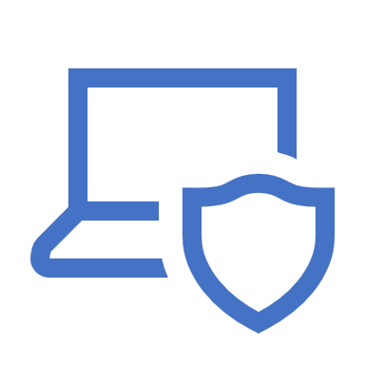
How they Make it Hurt
The CIA Triad
Confidentiality
Access to information
Privacy
Integrity
Information’s trustworthiness and accuracy
Availability
Reliable access to information by those who are authorized
✔

Slide 7



Protecting Your Company
(Abridged)

Slide 8


Protecting Your Company Why It Matters
Every company runs on information
Customer data
Employee data – people like getting paid
Proprietary information, trade secrets
Internal and external communications
It only takes one weak link in the chain
✔

Slide 9

Protecting Your Company Backing Up (and Restoring) Data
If you’d miss it, back it up
All that data your company runs on
Backing up is only half the battle
Can you restore it?
Data retention
Off-site backups
✔

Slide 10
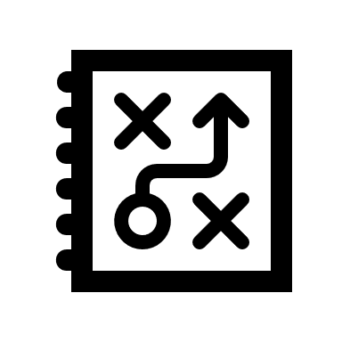
Protecting Your Company Encryption
Hiding and distorting information so it cannot be read
Encryption far pre-dates computers
Data at rest
On your computer, server, a USB drive
Data in transit
Email, IM, upload, download
What happens when you lose control of your data?
You must assume you will
✔

Slide 11

Protecting Your Company Physical Security
Who has access?
How do they enjoy that access?
Exceptions, visitors, emergencies
Power, utilities
Disasters
Human, natural, water, fire
Human safety is always top priority
✔

Slide 12

Protecting Your Company Social Engineering
Exploiting technology is hard
Exploiting humans is (comparatively) easy
Trust, helpfulness
Email, phone calls, IM, DM, spam, ads, any and every way of contacting a human
Urgency
Impersonation
Call to action
Expectations
Training makes a difference
✔

Slide 13

Protecting Your Company Phishing Crash Course
Urgency
Reply now/Your account will be deleted/etc
Misspelligs
Bogus sender
Click to expand, check headers
Bad links
URL shorteners in an email?
Unexpected attachment
Unexpected attachment format
Request for information
Use your gut
n
✔

Slide 14
Protecting Yourself

Slide 15
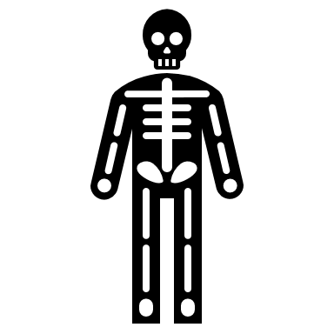
Protecting Yourself Why It Matters
“But I don’t have anything worth protecting” is denial
You have resources
If you lost your phone or computer for a day, what would happen? For a week? Forever?
You have access
✔

Slide 16
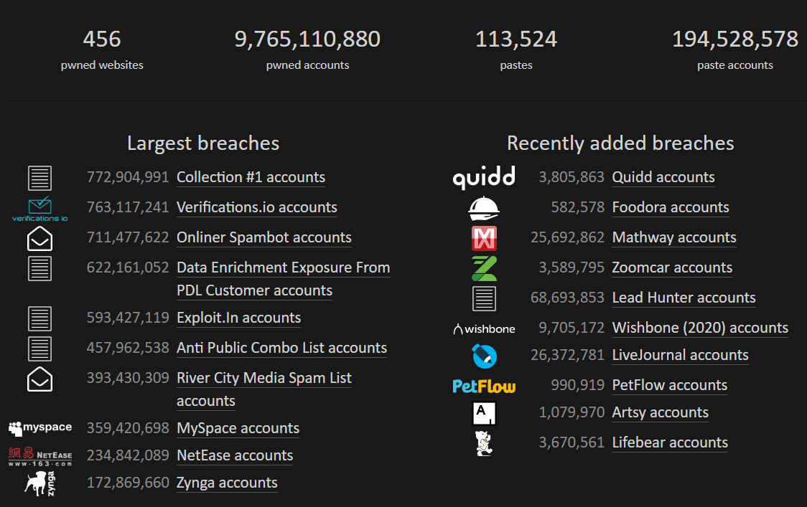
Passwords are terrible
From haveibeenpwned.com (July, 2020)
Password re-use kills
Sign up for haveibeenpwned
What do you do after you get pwned? Or hopefully before…
Create a unique username
Create a new and unique password
✔

Slide 17
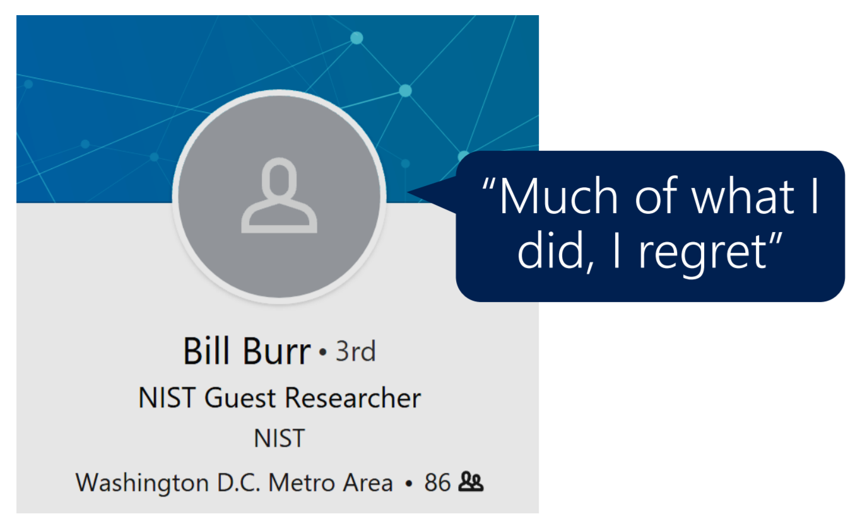
✔

Slide 18

Protecting Yourself Password Manager
Password re-use
A vault that holds your passwords and other credentials
Stop typing passwords
Better passwords
Backup and restore
Organization
Apps, plugins, etc. – passwords are everywhere you need them
LastPass, 1Password, Keepass, DashLane
✔

Slide 19
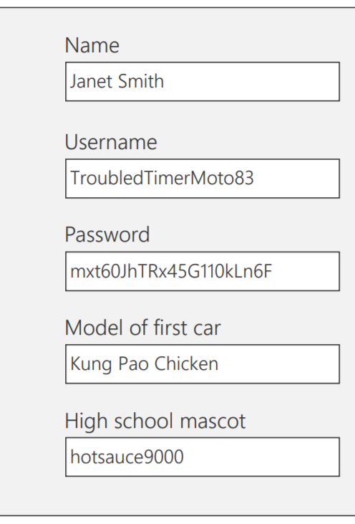
Another Password Manager Advantage
Do you answer security questions truthfully?
WHY?
"What's your Hogwarts Wand Name? Combine your hometown, first pet's name, mother's maiden name, model of your first car, and best friend's name."
iCloud hack exploited bad security questions/answers
Nobody said you have to answer security questions with real information
Store your bogus answers in your password manager
✔

Slide 20

Protecting Yourself Multi-Factor Authentication
Passwords are a weak form of authentication
Types of authentication
Type 1: Something you know
Passwords, PIN, secret handshake
Type 2: Something you have
Phone, token, a specific device
Type 3: Something you are
Fingerprint, iris/retinal scan, facial geometry, gait, palm scan, ear print
Is a username a form of authentication?
Is having a password and a PIN MFA?
Microsoft Authenticator, Google Authenticator, SMS, Yubico keys
✔

Slide 21
Protecting Yourself Personal VPN
Do you use wireless you don't own?
Coffee shops, hotels, etc.
Does your phone connect automatically to available wireless connections?
If you don't control the network's security, and sometimes even if you do, assume it's compromised
VPNs act as a go-between when you are using sketchy networks
Data is encrypted between you and the VPN server (which is off the sketchy network), and then sent normally to whatever endpoint
Don't cheap out - pay for your VPN
Security, no logging/reselling of data, reliability, flexibility, scale
NordVPN, Private Internet Access (PIA)
✔

Slide 22
Wrapping Up
Protecting Your Company
Every company runs on data
Backup and restore data
Encrypt data at rest and in transit
Physical security can’t be neglected
People are part of your attack surface
Protecting Yourself
You have resources and access
Sign up for haveibeenpwned
Use a password manager
Use bogus information in security questions
Multi-factor authentication
Use a personal VPN
✔

Slide 23
And for goodness sake, install updates and patches right away

Slide 24
Thank you!
Thomas Rayner
Certified Information Systems Security Professional (CISSP)
Sr Security Service Engineer @ Microsoft
@MrThomasRayner
✔

